Slide 1
Microcomputer Principles
&
Computer Interface
Lu Yin
luyin@nwpu.edu.cn

Slide 2
Chapter 10
Memory and Memory Interfacing
Contains and targets
  Calculate the chip capacity and organization of semiconductor memory chips
  Compare and contrast the variations of ROM: EPROM, EEPROM, FLASH and mask ROM
  Compare and contrast the variations of RAM: SRAM, DRAM
  Diagram methods of address decoding for memory chips
  Describe 16-bit memory design and related issues

Slide 3
Section10.1
Semiconductor Memories
Terminologies of memory
Memory Capacity
  Chip Capacity: the number of bits that a semiconductor memory chip can store.
  While the capacity of memory in computer is counting by bytes.
Memory Organization
  Memory chips are organized into a number of locations, and bits of each location depending on how it is designed internally. It equals to the data bus width.
  How many locations exist inside a memory chip depends on the number of address pins (2^{X} where x is the width of address bus)

Slide 4
Section10.1
Semiconductor Memories
To summarize:
  Each memory chip contains 2^{x} locations, where x is the width of address bus
  Each location contains y bits, where y is the width of data bus
  The entire chip will contain 2^{x} x y bits
  The 2^{x} x y is referred to as the organization of the memory chip.
Notes:
Equqtion 等式, eq算式 of bits that
2^{x} x y : 2 to the power of x , multiply y

Slide 5
Section10.1
Semiconductor Memories
Speed of memory chips
  The speed of the memory chip is commonly referred to as its access time.
  The speed of memory varies from a few nanoseconds to hundreds of nanoseconds.
Example 10-1
A given memory chip has 12 address pins and 8 data pins. Find:
a) the organization b) the capacity
Solution:
a) the chip has 2¹² = 4096 locations, and each location has 8 bits. So the organization is 2¹² x 8
b) the capacity is 4096 x 8 = 32768 bits (32K bits)
Notes:
Access time is defined as the time

Slide 6
Section10.1
Semiconductor Memories
ROM (read-only memory)
  ROM is also called nonvolatile memory. The bits written in is read only and will not lose while power lose.
PROM (programmable ROM)
  One-time programmable ROM
  Information is written into by blowing the internal fuse
EPROM (erasable programmable ROM)
  The unit is Capacitance based. Information is written into by charging, and may be erased by ultraviolet. It may take more than 15 minutes to erase a EPROM.

Slide 7
Section10.1
Semiconductor Memories
EEPROM (electrically erasable programmable ROM)
  The erasure is electrical and can be done on location basis
  EEPROM can be erased and programmed on board
Flash memory
  It is also electrically erasable, and can the entire progress may take only a few seconds.
  The erasure is done on chip basis
Mask ROM
  Mask ROM is manufacturer pre-programmed ROM chip. It is much cheaper than other types.
  Mask ROM is recommended only when the program burned in will not change in the future.

Slide 8
Section10.1
Semiconductor Memories
RAM (random access memory)
  RAM is also called volatile memory. There will be a info lose while power is cutting off.
  There is many type of RAM: static RAM, dynamic RAM, nonvolatile RAM
SRAM (static RAM)
  SRAM are made of flip-flops and do not require refreshing in order to keep their data
  SRAMs are widely used for cache memory
  CMOS SRAM is also a recommended choice in power limited embedded systems.

Slide 9
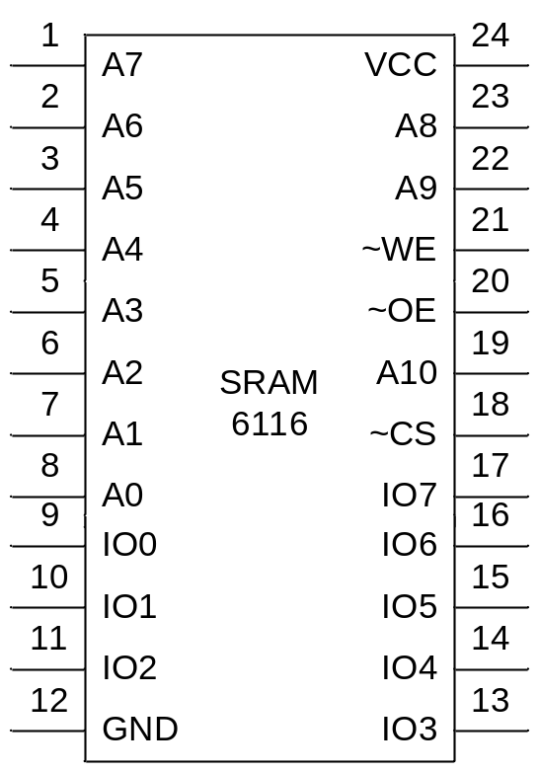
Section10.1
Semiconductor Memories
SRAM 6116 IC
  Capacity 2¹¹ x 8
  Address bus A0~A10
  Data bus IO0~IO7
  CS chip select
  WE write enable
  OE output enable

Slide 10
Section10.1
Semiconductor Memories
SRAM access :
  Write into
    Provide address to A0~A10
    Active CS
    Make WE=0 (active low)
    Provide data to pin IO0~IO7
    Make WE=1 and data will be written into SRAM
SRAM access:
  Read out
    Provide address to A0~A10
    Active CS
    While WE=1 (deactivated) , a high-to-low pulse on the OE pin will read the data out of the chip
    Access time elapse from AB available to DB available, and can vary from 100ns to 15ns

Slide 11
Section10.1
Semiconductor Memories
DRAM (dynamic RAM)
  DRAM use the capacitor of the collector in a transistor to store data.
  It needs refresh periodically
  DRAM chips are generally integrated into a single memory stick, and share the refreshing control circuit

Slide 12
Section10.1
Semiconductor Memories
Packaging issue in DRAM
  In order to reduce the address pins of a DRAM chip, the AB is multiplexed. The address is splitted into halves and send to the AB pin in sequence.
  Internal the chip, the DRAM structure is divided into a square of rows and columns. The first halve of address is used to address the row, and the second halve address is used to address the column. Thus a single memory unit can be selected.
  To access a bit of data from DRAM, both row and column address must be provided. And a 2-by-1 multiplexer is required out side the DRAM chip.

Slide 13
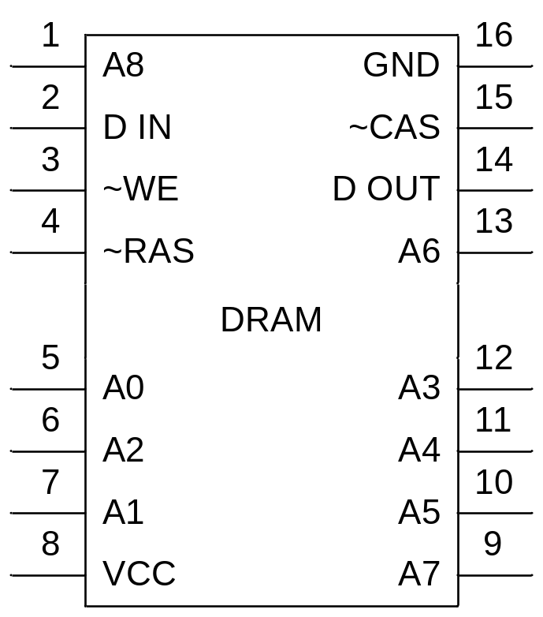
Section10.1
Semiconductor Memories
DRAM, SRAM, and ROM organizations
256K x 1 DRAM
  A0~A7: Address bus
  D IN: 1 bit data input
  D OUT: 1 bit data output
  WE: write enable
  RAS: Row Address Strobe
  CAS: Col Address Strobe

Slide 14
Section10.1
Semiconductor Memories
DRAM, SRAM, and ROM organizations
Example 10-4
Show possible organizations and number of address pins for the:
(a) 256K DRAM chip (b) 1M DRAM chip
Solution:
For a 256K DRAM, the chip may have the organization of 256K x1 or 64K x 4
For a 1M DRAM, the organization may be 1M x1 or 256K x4

Slide 15
Section10.1
Semiconductor Memories
NV-RAM (nonvolatile RAM)
  The data unit is the same with CMOS SRAM (4 transistors)
  A micro lithium battery is integrated
  also with a power control unit

Slide 16
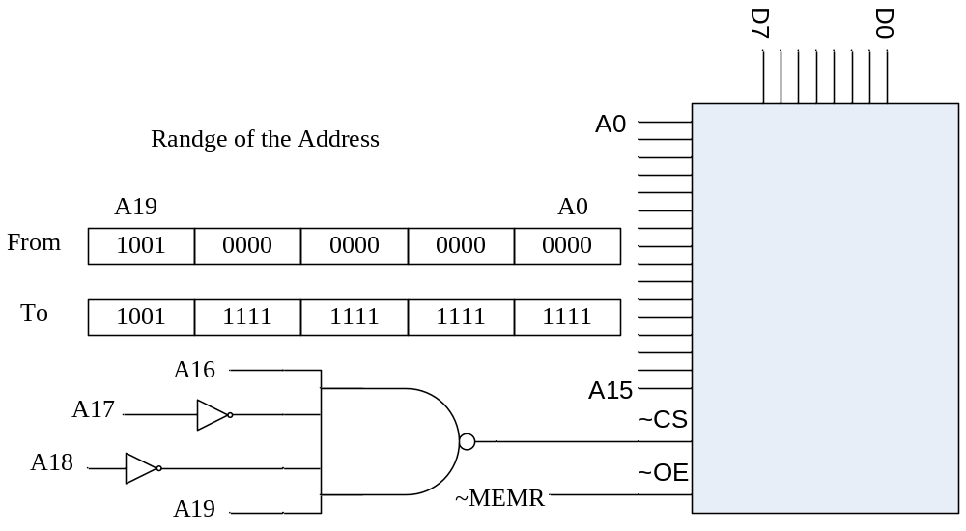
Section10.2
Memory Address Decoding
An address decoder unit is used to provide the CS (generally activity low)

Slide 17
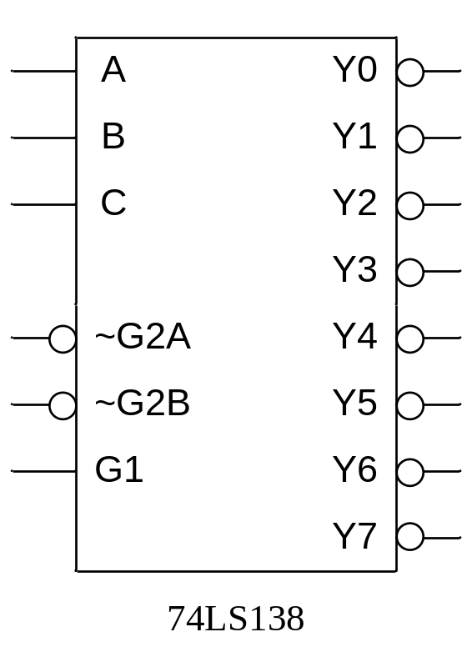
Section10.2
Memory Address Decoding
Using the 74LS138 as decoder
  74LS138 is a 3-to-8 decoder
  ABC are address inputs
  G1, G2A, G2B is control pin, and can be linked with both address bus and control bus

Slide 18
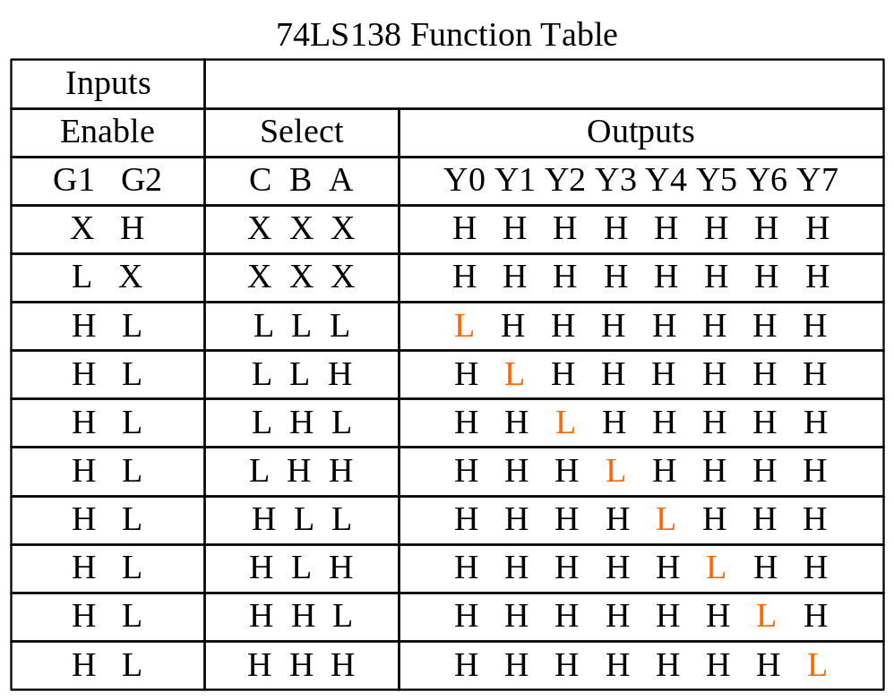
Section10.2
Memory Address Decoding

Slide 19
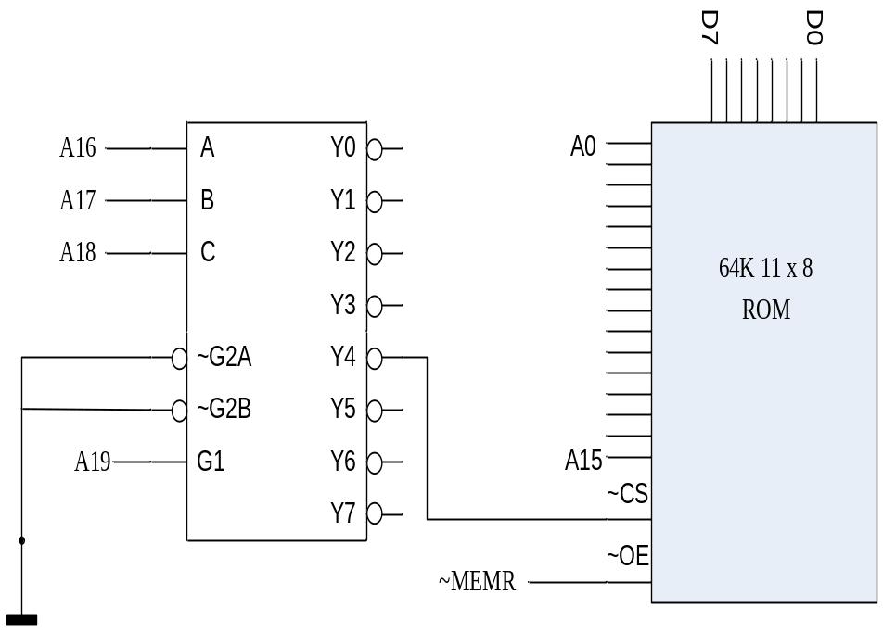
Section10.2
Memory Address Decoding
Calculate the address below: (Figure 10-12)
Solution:
Enable 74LS138 Encoder
  A19 = 1
Enable the output pin
  A18A17A16=100
Address range
  A15~A0 ranges from all low to all high. And that would be 2¹⁶ (=65536) bytes

Slide 20
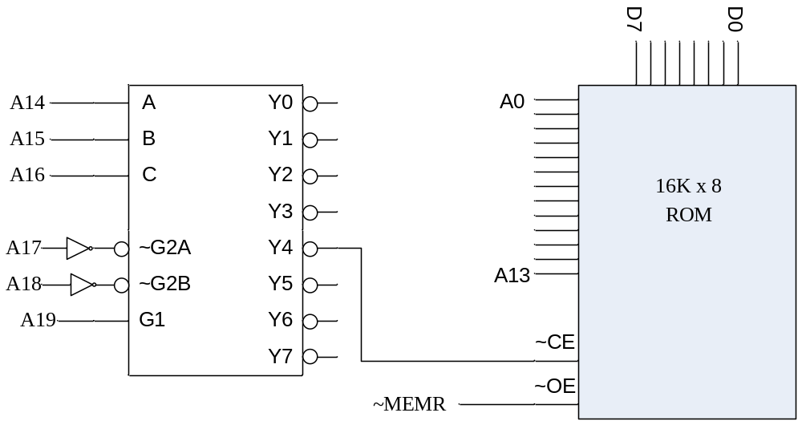
Section10.2
Memory Address Decoding
Calculate the address below: (Example10-7)
Solution:
Enable 138
  A19~A17=111B
Enable Y4
A16~A14=100B
Calculate Range
  A13~A0=All low to All high
  That is 16K bytes

Slide 21
Section10.2
Memory Address Decoding
How to calculate address ranges of memory?
  1. write down all the address bus pins involved;
  2. assign values to the AB pins so that to activate the ~CS pin of the memory IC (truth table of the decoder circuit may be required);
  3. assign ‘0’ to the AB pins of the memory IC to get the lower range; assign ‘1’ to them to get the upper range.

Slide 22
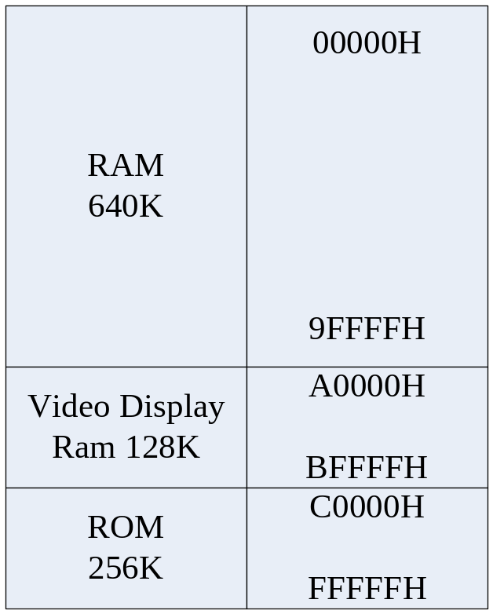
Section10.3
IBM PC Memory MAP
The organization of IBM PC memory space
  Conventional memory
  Video display RAM
  BIOS data area
  Interrupt vector table in the beginning of the conventional memory

Slide 23
Section10.3
IBM PC Memory MAP
ROM Address and cold boot in the PC
  When the PC is RESET, ROM BIOS is the memory block that is accessed first by the CPU.
  A upper pulse input from the RESET pin of the CPU, will reset CS:IP to FFFF:0000, and the PA will be FFFF0H, locate at the beginning of ROM space.
  At the end of BIOS program, the operating system will be load to RAM from hard disc, and the control of the PC will be handed to the OS.

Slide 24
Section10.4
Data Integrity in RAM and ROM
Checksum Byte
  Checksum byte is for a block of memory
  To calculate the checksum byte, all the bytes in the block will be added up, and carry out will be discarded, then the 2’s complement of the sum should be produced and taken as the checksum.
  To verify the integrity of a block, the bytes in the block and the checksum byte together, should be added up. If the result is zero (discard the carry out), then there is no corruption within the block.
Parity Bit
  Append one parity bit for each location in the memory space
  Two types of parity: ODD and EVEN.

Slide 25
Chapter 10
Memory and Memory Interfacing
Summery: How to design the memory map for a computer system (excluding IO space)
  1) knowing the CPU: width of data/address bus, control bus definition, the starting place
  2) allocating memory space for ROM and RAM
  3) select memory chips: different chip organization may have different construction
  4) encoding the address, use 74LS138 or other encoder ICs
  5) address buffer and boost, data bus boost, local bus and system bus isolation

